Slide 1
Proofs: Propositional Logic
CS 236
Fall 2023

Slide 2
Overview
Topics
Brief review of truth tables, tautologies, contradictions, logical equivalences
Logical equivalences vs rules of inference
Proof techniques: Deduction, contradiction, resolution with contradiction
Project 2 hackathon on Wednesday
There will be two groups: those of you who have started and those of you who have not.
Due
Homework 9a and 9b due Wednesday, Oct 11
Project 2 due Monday, Oct 16
Midterm Oct 24--27

Slide 3
Propositions and Possible Worlds

Slide 4
Review
Propositions
p = “I’m elected”
q = “I’ll lower taxes”
Possible Worlds
true or false
true or false
Compound proposition – the building blocks

Slide 5
Review
Propositions
p = “I’m elected”
q = “I’ll lower taxes”
Possible Worlds
true or false
true or false
Compound proposition – the building blocks

Slide 6
Review
Propositions
p = “I’m elected”
q = “I’ll lower taxes”
Possible Worlds
true or false
true or false
Compound proposition – the building blocks

Slide 7
Review
Propositions
p = “I’m elected”
q = “I’ll lower taxes”
Possible Worlds
true or false
true or false
Compound proposition – the building blocks

Slide 8
Review
Propositions
p = “I’m elected”
q = “I’ll lower taxes”
Possible Worlds
true or false
true or false
Compound proposition – the building blocks

Slide 9
Review
Propositions
p = “I’m elected”
q = “I’ll lower taxes”
Possible Worlds
true or false
true or false
Compound proposition – the building blocks

Slide 10
Review
Compound proposition – give me some examples

Slide 11
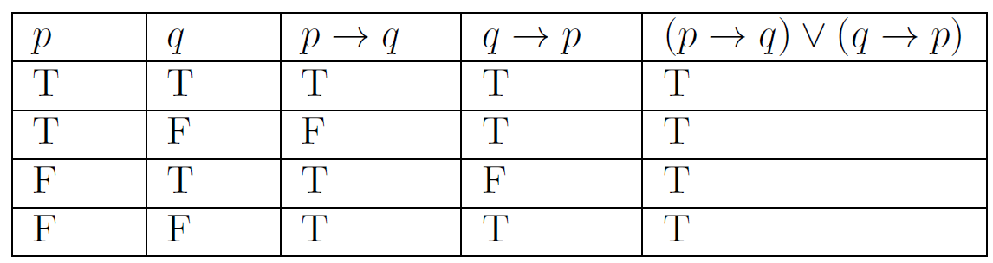
Review
p → q is read “if p then q”
p = “I’m elected”
q = “I’ll lower taxes”
p→q is like an observation or assertion about the world, something we claim holds
p → q weird truth table
what is it
how do we interpret it
Does the assertion hold when the world looks like this?
p is the premise. When the premise if false, the assertion is true

Slide 12
Review
A tautology is a compound proposition that is always true
Definition 1 from Section 1.3.1
Which of the following compound propositions are tautologies?
p ∨ ¬p
p ∨ q
(p→q) ∨ (q→p)

Slide 13
Review
A tautology is a compound proposition that is always true
Definition 1 from Section 1.3.1
Which of the following compound propositions are tautologies?
p ∨ ¬p
p ∨ q
(p→q) ∨ (q→p)
Tautology: Doesn’t matter what world I’m in, the compound proposition is true

Slide 14

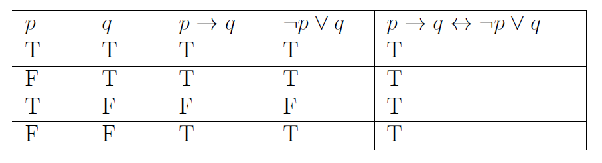
Review
Compound propositions w and v are called logically equivalent if w ↔ v is a tautology (Definition 2, from Section 1.3.2)
We denote that w and v are called logically equivalent by w ≡ v
w = p ⟶ q
v = ¬p ∨ q
Example, conditional-disjunction equivalence:
✓

Slide 15
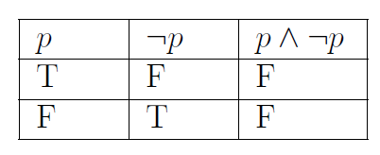
Review
A contradiction is a compound proposition that is always false
Definition 1 from Section 1.3.1
Is the following compound proposition a contradiction?
p ∧ ¬p

Slide 16
Review
A contradiction is a compound proposition that is always false
Definition 1 from Section 1.3.1
Is the following compound proposition a contradiction?
p ∧ ¬p
Contradiction: Doesn’t matter what world I’m in, the compound proposition is not true

Slide 17
Tools for Doing Proofs

Slide 18
What is a Proof?
Identify facts in the world

Slide 19
What is a Proof?
Identify facts in the world
Use logic to derive new facts

Slide 20
What is a Proof?
Identify facts in the world
Use logic to derive new facts
Conclude an interesting fact

Slide 21
What is a Proof? Propositional Logic
Identify facts in the world
Use logic to derive new facts
Conclude an interesting fact
In propositional logic, facts are represented as propositions

Slide 22
What is a Proof? Logical Equivalences
Identify facts in the world
Use logic to derive new facts
Conclude an interesting fact
In propositional logic, facts are represented as propositions
No matter what facts are true, you can do this substitution

Slide 23
Common Logical Equivalences
HW
Photo Op
We denote that p and q are called logically equivalent by p ≡ q
Section 1.3.2
Table 4
Table 6
Table 7
Table 8
Label the top entry in Table 7
conditional disjunction equivalence

Slide 24
Using a Logical Equivalence
p → q Premise
q → s Premise
p Premise
We call the facts given to us in the world premises

Slide 25
Using a Logical Equivalence
p → q Premise
q → s Premise
p Premise
¬p ∨ q Conditional disjunction equivalence on 1
We call the facts given to us in the world premises
We use a logical equivalence to derive a new “fact”

Slide 26
Two Proof Tools for Propositional Logic
Logical Equivalences
Structure
Replace one fact with another
Use
Tautology
Foundation

Slide 27
Two Proof Tools for Propositional Logic
Logical Equivalences
Rules of Inference
Structure
Replace one fact with another
Derive new fact from two others
Use
Tautology
Foundation
Implication

Slide 28
Rules of Inference

Slide 29
What is a Proof? Rules of Inference
Identify facts in the world
Use logic to derive new facts
Conclude an interesting fact
In propositional logic, facts are represented as propositions
Can only derive q if both p and p ⟶ q are facts in the world

Slide 30

Rules of Inference (Table 1 section 1.6.3)
Think of them as useful implications
Read as “therefore”
Rule of inference form

Slide 31
Rules of Inference (Table 1 section 1.6.3)
Think of them as useful implications
If these two things are in my knowledge base
Rule of inference form

Slide 32
Rules of Inference (Table 1 section 1.6.3)
Think of them as useful implications
If these two things are in my knowledge base
then I can add this thing to my knowledge base
Rule of inference form

Slide 33
”Use truth table method to show that the following arguments are sound”

Slide 34
”Use truth table method to show that the following arguments are sound”
Worlds where p is true

Slide 35
”Use truth table method to show that the following arguments are sound”
Worlds where p⟶q is true

Slide 36
”Use truth table method to show that the following arguments are sound”
Worlds where both are true

Slide 37
”Use truth table method to show that the following arguments are sound”
q is true in this world

Slide 38
Rules of Inference (Table 1 section 1.6.3)
Think of them as useful implications
If these two things are in my knowledge base
then I can add this thing to my knowledge base
Rule of inference form
I can infer new things from what I know

Slide 39
Rules of Inference (Table 1 section 1.6.3)
Think of them as useful implications
If these two things are in my knowledge base
Rule of inference form
Implication form

Slide 40
Rules of Inference (Table 1 section 1.6.3)
Think of them as useful implications
If these two things are in my knowledge base
then I can add this thing to my knowledge base
Rule of inference form
Implication form

Slide 41
Common Rules of Inference
HW
Photo Op
Frequently encountered rules
modus ponens
modus tollens
disjunctive syllogism
resolution
Section 1.6.3
Table 1

Slide 42
Using the Logical Equivalences and Rules of Inference

Slide 43
What are Proofs?
Given a set of premises (the knowledge base)
Establish some conclusion
Proofs are valid arguments
An argument is a sequence of statements
We call the last statement the conclusion and all proceeding statements are premises
An argument is valid when the conclusion must be true when all premises are true

Slide 44
Three proof patterns
Deduction
Contradiction
Resolution and Contradiction

Slide 45
Deduction

Slide 46
Deduction
We deduce a conclusion from existing premises to create new facts using logical equivalences or rules of inference
Prove s given the following premises:
p → q Premise
q → s Premise
p Premise

Slide 47
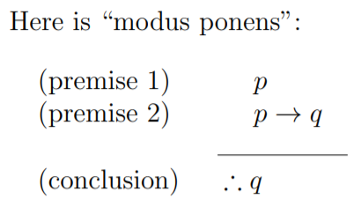
Deduction
We deduce a conclusion from existing premises to create new facts using logical equivalences or rules of inference
Prove s given the following premises:
p → q Premise
q → s Premise
p Premise
q Modus Ponens using 1 and 3

Slide 48
Deduction
We deduce a conclusion from existing premises to create new facts using logical equivalences or rules of inference
Prove s given the following premises:
p → q Premise
q → s Premise
p Premise
q Modus Ponens using 1 and 3
s Modus Ponens using 2 and 4

Slide 49
Deduction
We deduce a conclusion from existing premises to create new facts using logical equivalences or rules of inference
Prove s given the following premises:
p → q Premise
q → s Premise
p Premise
q Modus Ponens using 1 and 3
s Modus Ponens using 2 and 4
s
starting premises
deductions
conclusion

Slide 50
Deduction
We can use deduction as a proof technique
We deduce a conclusion by using existing premises to create new facts using logical equivalences or rules of inference
Prove s given the following premises:
p → q Premise
q → s Premise
p Premise
q Modus Ponens using 1 and 3
s Modus Ponens using 2 and 4
fact reason
Use this “T structure”

Slide 51
Contradiction

Slide 52
Contradiction
Negate the desired conclusion, then deduce new facts until we reach a contradiction (false)
Prove s by contradiction:
p → q Premise
q → s Premise
p Premise

Slide 53
Contradiction
Negate the desired conclusion, then deduce new facts until we reach a contradiction (false)
Prove s by contradiction:
p → q Premise
q → s Premise
p Premise
If we try to “squeeze” something
false into a true knowledge base
we end up with something ridiculous

Slide 54
Contradiction
Negate the desired conclusion, then deduce new facts until we reach a contradiction (false)
Prove s by contradiction:
p → q Premise
q → s Premise
p Premise
Steps:
Collect what we know
Identify what we want to prove
Negate it
Reason
Reach something absurd
Conclude

Slide 55
Contradiction
Negate the desired conclusion, then deduce new facts until we reach a contradiction (false)
Prove s by contradiction:
p → q Premise
q → s Premise
p Premise
Steps:
Collect what we know
Identify what we want to prove
Negate it
Reason
Reach something absurd
Conclude
“the plan of redemption [is] brought about only on conditions of repentance”
-- Alma to Corianton (Alma 42:13)

Slide 56
Contradiction
Negate the desired conclusion, then deduce new facts until we reach a contradiction (false)
Prove s by contradiction:
p → q Premise
q → s Premise
p Premise
Steps:
Collect what we know
Identify what we want to prove
Negate it
Reason
Reach something absurd
Conclude
“the plan of redemption [is] brought about only on conditions of repentance”
-- Alma to Corianton (Alma 42:13)
“were it not for these conditions …”
Negate the thing we want to prove

Slide 57
Contradiction
Negate the desired conclusion, then deduce new facts until we reach a contradiction (false)
Prove s by contradiction:
p → q Premise
q → s Premise
“the plan of redemption [is] brought about only on conditions of repentance”
-- Alma to Corianton (Alma 42:13)
Steps:
Collect what we know
Identify what we want to prove
Negate it
Reason
Reach something absurd
Conclude
“were it not for these conditions …”
mercy could not take effect except it should destroy the work of justice.
“and God would cease to be God”
do some reasoning

Slide 58
Contradiction
Negate the desired conclusion, then deduce new facts until we reach a contradiction (false)
Prove s by contradiction:
p → q Premise
q → s Premise
“the plan of redemption [is] brought about only on conditions of repentance”
-- Alma to Corianton (Alma 42:13)
Steps:
Collect what we know
Identify what we want to prove
Negate it
Reason
Reach something absurd
Conclude
“were it not for these conditions …”
mercy could not take effect except it should destroy the work of justice.
“and God would cease to be God”
“and God would cease to be God”
Reach something absurd

Slide 59
Contradiction
Negate the desired conclusion, then deduce new facts until we reach a contradiction (false)
Prove s by contradiction:
p → q Premise
q → s Premise
p Premise
Steps:
Collect what we know
Identify what we want to prove
Negate it
Reason
Reach something absurd
Conclude
Things we know (our knowledge base)

Slide 60
Contradiction
Negate the desired conclusion, then deduce new facts until we reach a contradiction (false)
Prove s by contradiction:
p → q Premise
q → s Premise
p Premise
Steps:
Collect what we know
Identify what we want to prove
Negate it
Reason
Reach something absurd
Conclude

Slide 61
Contradiction
Negate the desired conclusion, then deduce new facts until we reach a contradiction (false)
Prove s by contradiction:
p → q Premise
q → s Premise
p Premise
¬s Negate the conclusion, s
Steps:
Collect what we know
Identify what we want to prove
Negate it
Reason
Reach something absurd
Conclude

Slide 62
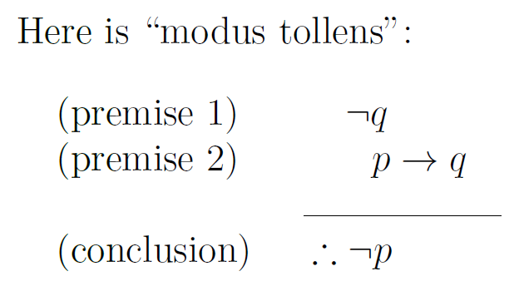
Contradiction
Negate the desired conclusion, then deduce new facts until we reach a contradiction (false)
Prove s by contradiction:
p → q Premise
q → s Premise
p Premise
¬s Negate the conclusion, s
¬q Modus Tollens using 2 and 4

Slide 63
Contradiction
Negate the desired conclusion, then deduce new facts until we reach a contradiction (false)
Prove s by contradiction:
p → q Premise
q → s Premise
p Premise
¬s Negate the conclusion, s
¬q Modus Tollens using 2 and 4
Steps:
Collect what we know
Identify what we want to prove
Negate it
Reason
Reach something absurd
Conclude

Slide 64
Contradiction
Negate the desired conclusion, then deduce new facts until we reach a contradiction (false)
Prove s by contradiction:
p → q Premise
q → s Premise
p Premise
¬s Negate the conclusion, s
¬q Modus Tollens using 2 and 4
¬p Modus Tollens using 1 and 5
F second Negation law (Section 1.3.1 Table 6)

Slide 65
Contradiction
Negate the desired conclusion, then deduce new facts until we reach a contradiction (false)
Prove s by contradiction:
p → q Premise
q → s Premise
p Premise
¬s Negate the conclusion, s
¬q Modus Tollens using 2 and 4
¬p Modus Tollens using 1 and 5
F second Negation law (Section 1.3.1 Table 6)
If we try to “squeeze” something
false into a true knowledge base
we end up with something ridiculous
“and God would cease to be God”

Slide 66
Contradiction
Negate the desired conclusion, then deduce new facts until we reach a contradiction (false)
Prove s by contradiction:
p → q Premise
q → s Premise
p Premise
¬s Negate the conclusion, s
¬q Modus Tollens using 2 and 4
¬p Modus Tollens using 1 and 5
F second Negation law (Section 1.3.1 Table 6)
Steps:
Collect what we know
Identify what we want to prove
Negate it
Reason
Reach something absurd
Conclude

Slide 67
Contradiction
Negate the desired conclusion, then deduce new facts until we reach a contradiction (false)
Prove s by contradiction:
p → q Premise
q → s Premise
p Premise
¬s Negate the conclusion, s
¬q Modus Tollens using 2 and 4
¬p Modus Tollens using 1 and 5
F second Negation law (Section 1.3.1 Table 6)
s contradiction at 7

Slide 68
Contradiction
Negate the desired conclusion, then deduce new facts until we reach a contradiction (false)
Prove s by contradiction:
p → q Premise
q → s Premise
p Premise
¬s Negate the conclusion, s
¬q Modus Tollens using 2 and 4
¬p Modus Tollens using 1 and 5
F second Negation law (Section 1.3.1 Table 6)
s contradiction at 7
starting premises
deductions
contradiction
conclusion

Slide 69
Contradiction
Negate the desired conclusion, then deduce new facts until we reach a contradiction (false)
Prove s by contradiction:
p → q Premise
q → s Premise
p Premise
¬s Negate the conclusion, s
¬q Modus Tollens using 2 and 4
¬p Modus Tollens using 1 and 5
F second Negation law (Section 1.3.1 Table 6)
s contradiction at 7
If we try to “squeeze” something
false into a true knowledge base
we end up with something ridiculous
…
which means the negation of the false
thing is true

Slide 70
Resolution with Contradiction

Slide 71
Resolution: last line of table 1 section 1.6.3

Slide 72
Resolution
The Pattern
p on the first line
not p on the second
the q from the first line is or’d with the r from the second line

Slide 73
Resolution
Given this conjunction of facts (p → q) ∧ (q → s) ∧ p
Prove s

Slide 74
Resolution
Given this conjunction of facts (p → q) ∧ (q → s) ∧ p
Prove s
Reframing
(p → q) ∧ (q → s) ∧ p Premise
p → q Simplification on 1
q → s Simplification on 1
p Simplification on 1
Let’s just start with the knowledge base in this form

Slide 75
Resolution
Prove s by contradiction:
p → q Premise
q → s Premise
p Premise
¬s Negate the conclusion, s
¬q Modus Tollens using 2 and 4
¬p Modus Tollens using 1 and 5
F second Negation law (Section 1.3.1 Table 6)

Slide 76
Resolution
Prove s by contradiction:
p → q Premise
q → s Premise
p Premise
¬s Negate the conclusion, s
¬q Modus Tollens using 2 and 4
¬p Modus Tollens using 1 and 5
F second Negation law (Section 1.3.1 Table 6)
The facts in our knowledge base don’t match the pattern needed for resolution!

Slide 77
Resolution
We can always write our premises in the correct form!
When I ask you to use only resolution and proof by contradiction, I’ll give you the premises in the correct form
Prove s by contradiction:
¬p∨q Premise
¬q∨s Premise
p Premise
¬s Negate the conclusion, s
¬q Resolution 2 and 4
¬p Resolution 1 and 5
F Resolution 3 and 6

Slide 78
Resolution
Prove s by contradiction:
¬p∨q Premise
¬q∨s Premise
p Premise
¬s Negate the conclusion, s
¬q Resolution 2 and 4
¬p Resolution 1 and 5
F Resolution 3 and 6

Slide 79
Resolution
Prove s by contradiction:
¬p∨q Premise
¬q∨s Premise
p Premise
¬s Negate the conclusion, s
¬q Resolution 2 and 4
¬p Resolution 1 and 5
F Resolution 3 and 6

Slide 80
Resolution
Prove s by contradiction:
¬p∨q Premise
¬q∨s Premise
p Premise
¬s Negate the conclusion, s
¬q Resolution 2 and 4
¬p Resolution 1 and 5
F Resolution 3 and 6

Slide 81
Resolution
Multiple forms

Slide 82
Resolution
Prove s by contradiction:
¬p∨q Premise
¬q∨s Premise
p Premise
¬s Negate the conclusion, s
¬q Resolution 2 and 4
¬p Resolution 1 and 5
F Resolution 3 and 6

Slide 83
Resolution
Multiple forms

Slide 84
Resolution
Prove s by contradiction:
¬p∨q Premise
¬q∨s Premise
p Premise
¬s Negate the conclusion, s
¬q Resolution 2 and 4
¬p Resolution 1 and 5
F Resolution 3 and 6

Slide 85
Resolution
Prove s by contradiction:
¬p∨q Premise
¬q∨s Premise
p Premise
¬s Negate the conclusion, s
¬q Resolution 2 and 4
¬p Resolution 1 and 5
F Resolution 3 and 6
The therefore s by contradiction

Slide 86
Resolution
Multiple forms

